Slide 1
4.1.1 Decision Tree

Slide 2
Algorithm for Decision Tree Induction
Basic algorithm (a greedy algorithm)
Tree is constructed in a top-down recursive divide-and-conquer manner
At start, all the training examples are at the root
Attributes are categorical (if continuous-valued, they are discretized in advance)
Examples are partitioned recursively based on selected attributes
Test attributes are selected on the basis of a heuristic or statistical measure (e.g., information gain, gain ratio, gini index)
Conditions for stopping partitioning
All samples for a given node belong to the same class
There are no remaining attributes for further partitioning – majority voting is employed for classifying the leaf
There are no samples left

Slide 3
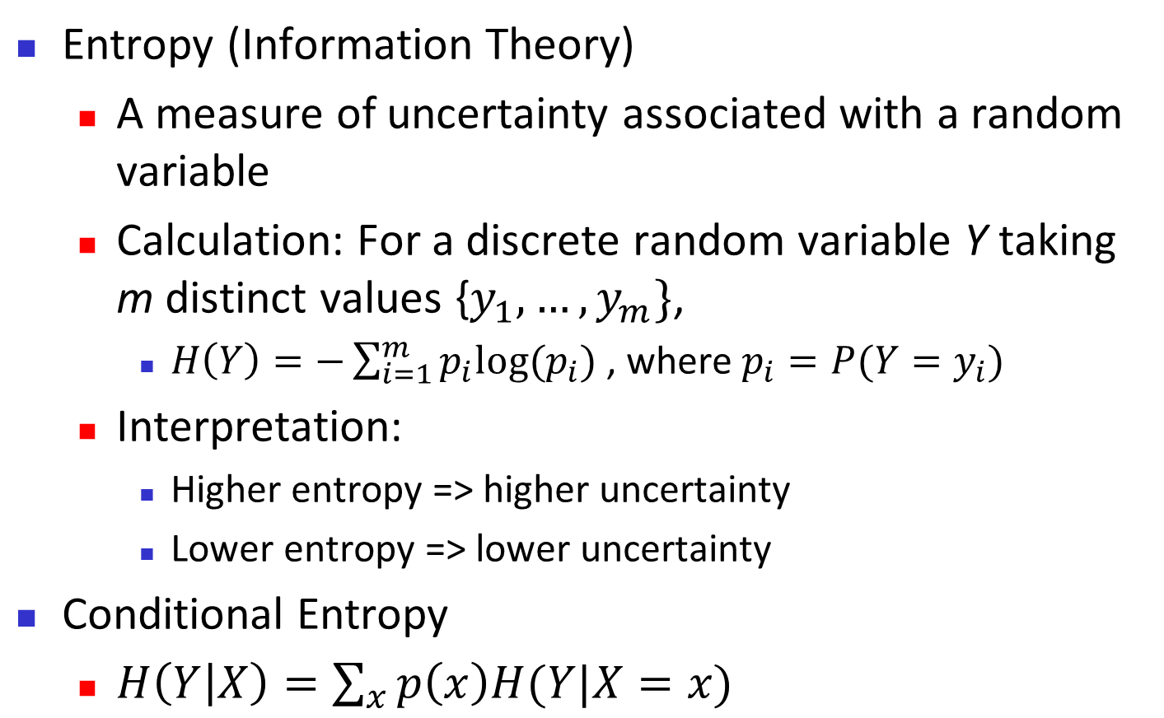
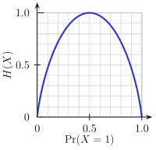
Brief Review of Entropy
m = 2

Slide 4
Attribute Selection Measure: Information Gain (ID3)
Select the attribute with the highest information gain
Let p_{i} be the probability that an arbitrary tuple in D belongs to class C_{i}, estimated by | C_{i}, D|/|D|
Expected information (entropy) needed to classify a tuple in D:
Information needed (after using A to split D into v partitions) to classify D:
Information gained by branching on attribute A

Slide 5
Attribute Selection: Information Gain
Class P: buys_computer = “yes”
Class N: buys_computer = “no”
means “age <=30” has 5 out of 14 samples, with 2 yes’es and 3 no’s. Hence
Similarly,

Slide 6
Computing Information-Gain for Continuous-Valued Attributes
Let attribute A be a continuous-valued attribute
Must determine the best split point for A
Sort the value A in increasing order
Typically, the midpoint between each pair of adjacent values is considered as a possible split point
(a_{i}+a_{i+1})/2 is the midpoint between the values of a_{i} and a_{i+1}
The point with the minimum expected information requirement for A is selected as the split-point for A
Split:
D₁ is the set of tuples in D satisfying A ≤ split-point, and D₂ is the set of tuples in D satisfying A > split-point

Slide 7
Tahapan Algoritma Decision Tree (ID3)
Siapkan data training
Pilih atribut sebagai akar
Buat cabang untuk tiap-tiap nilai
Ulangi proses untuk setiap cabang sampai semua kasus pada cabang memiliki kelas yg sama

Slide 8
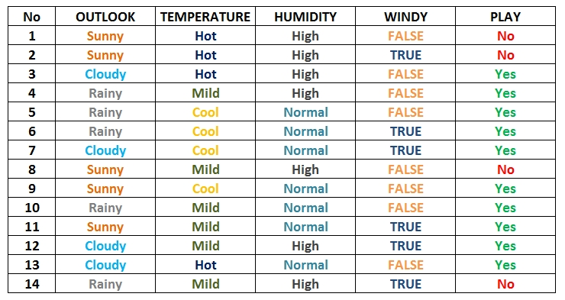
1. Siapkan data training

Slide 9
2. Pilih atribut sebagai akar
Untuk memilih atribut akar, didasarkan pada nilai Gain tertinggi dari atribut-atribut yang ada. Untuk mendapatkan nilai Gain, harus ditentukan terlebih dahulu nilai Entropy
Rumus Entropy:
S = Himpunan Kasus
n = Jumlah Partisi S
pi = Proporsi dari Si terhadap S
Rumus Gain:
S = Himpunan Kasus
A = Atribut
n = Jumlah Partisi Atribut A
| Si | = Jumlah Kasus pada partisi ke-i
| S | = Jumlah Kasus dalam S

Slide 10
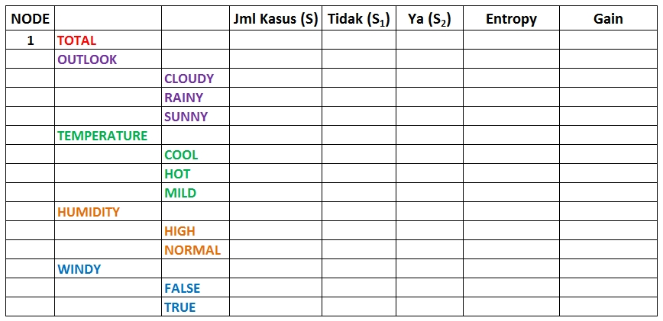
Perhitungan Entropy dan Gain Akar

Slide 11
Penghitungan Entropy Akar
Entropy Total
Entropy (Outlook)
Entropy (Temperature)
Entropy (Humidity)
Entropy (Windy)

Slide 12
Penghitungan Entropy Akar
NODE | ATRIBUT |  | JML KASUS (S) | YA (Si) | TIDAK (Si) | ENTROPY | GAIN
1 | TOTAL |  | 14 | 10 | 4 | 0,86312
 | OUTLOOK
 |  | CLOUDY | 4 | 4 | 0 | 0
 |  | RAINY | 5 | 4 | 1 | 0,72193
 |  | SUNNY | 5 | 2 | 3 | 0,97095
 | TEMPERATURE
 |  | COOL | 4 | 0 | 4 | 0
 |  | HOT | 4 | 2 | 2 | 1
 |  | MILD | 6 | 2 | 4 | 0,91830
 | HUMADITY
 |  | HIGH | 7 | 4 | 3 | 0,98523
 |  | NORMAL | 7 | 7 | 0 | 0
 | WINDY
 |  | FALSE | 8 | 2 | 6 | 0,81128
 |  | TRUE | 6 | 4 | 2 | 0,91830

Slide 13
Penghitungan Gain Akar

Slide 14
Penghitungan Gain Akar
NODE | ATRIBUT |  | JML KASUS (S) | YA (Si) | TIDAK (Si) | ENTROPY | GAIN
1 | TOTAL |  | 14 | 10 | 4 | 0,86312
 | OUTLOOK |  |  |  |  |  | 0,25852
 |  | CLOUDY | 4 | 4 | 0 | 0
 |  | RAINY | 5 | 4 | 1 | 0,72193
 |  | SUNNY | 5 | 2 | 3 | 0,97095
 | TEMPERATURE |  |  |  |  |  | 0,18385
 |  | COOL | 4 | 0 | 4 | 0
 |  | HOT | 4 | 2 | 2 | 1
 |  | MILD | 6 | 2 | 4 | 0,91830
 | HUMADITY |  |  |  |  |  | 0,37051
 |  | HIGH | 7 | 4 | 3 | 0,98523
 |  | NORMAL | 7 | 7 | 0 | 0
 | WINDY |  |  |  |  |  | 0,00598
 |  | FALSE | 8 | 2 | 6 | 0,81128
 |  | TRUE | 6 | 4 | 2 | 0,91830

Slide 15
Gain Tertinggi Sebagai Akar
Dari hasil pada Node 1, dapat diketahui bahwa atribut dengan Gain tertinggi adalah HUMIDITY yaitu sebesar 0.37051
Dengan demikian HUMIDITY dapat menjadi node akar
Ada 2 nilai atribut dari HUMIDITY yaitu HIGH dan NORMAL. Dari kedua nilai atribut tersebut, nilai atribut NORMAL sudah mengklasifikasikan kasus menjadi 1 yaitu keputusan-nya Yes, sehingga tidak perlu dilakukan perhitungan lebih lanjut
Tetapi untuk nilai atribut HIGH masih perlu dilakukan perhitungan lagi
1. HUMIDITY
High
Normal
1.1
?????
Yes

Slide 16
2. Buat cabang untuk tiap-tiap nilai
Untuk memudahkan, dataset di filter dengan mengambil data yang memiliki kelembaban HUMADITY=HIGH untuk membuat table Node 1.1
OUTLOOK | TEMPERATURE | HUMIDITY | WINDY | PLAY
Sunny | Hot | High | FALSE | No
Sunny | Hot | High | TRUE | No
Cloudy | Hot | High | FALSE | Yes
Rainy | Mild | High | FALSE | Yes
Sunny | Mild | High | FALSE | No
Cloudy | Mild | High | TRUE | Yes
Rainy | Mild | High | TRUE | No

Slide 17
Perhitungan Entropi Dan Gain Cabang
NODE | ATRIBUT |  | JML KASUS (S) | YA (Si) | TIDAK (Si) | ENTROPY | GAIN
1.1 | HUMADITY |  | 7 | 3 | 4 | 0,98523
 | OUTLOOK |  |  |  |  |  | 0,69951
 |  | CLOUDY | 2 | 2 | 0 | 0
 |  | RAINY | 2 | 1 | 1 | 1
 |  | SUNNY | 3 | 0 | 3 | 0
 | TEMPERATURE |  |  |  |  |  | 0,02024
 |  | COOL | 0 | 0 | 0 | 0
 |  | HOT | 3 | 1 | 2 | 0,91830
 |  | MILD | 4 | 2 | 2 | 1
 | WINDY |  |  |  |  |  | 0,02024
 |  | FALSE | 4 | 2 | 2 | 1
 |  | TRUE | 3 | 1 | 2 | 0,91830

Slide 18
Gain Tertinggi Sebagai Node 1.1
Dari hasil pada Tabel Node 1.1, dapat diketahui bahwa atribut dengan Gain tertinggi adalah OUTLOOK yaitu sebesar 0.69951
Dengan demikian OUTLOOK dapat menjadi node kedua
Artibut CLOUDY = YES dan SUNNY= NO sudah mengklasifikasikan kasus menjadi 1 keputusan, sehingga tidak perlu dilakukan perhitungan lebih lanjut
Tetapi untuk nilai atribut RAINY masih perlu dilakukan perhitungan lagi
1. HUMIDITY
High
Normal
1.1
OUTLOOK
Yes
Cloudy
Sunny
Rainy
Yes
1.1.2
?????
No

Slide 19
3. Ulangi proses untuk setiap cabang sampai semua kasus pada cabang memiliki kelas yg sama
OUTLOOK | TEMPERATURE | HUMIDITY | WINDY | PLAY
Rainy | Mild | High | FALSE | Yes
Rainy | Mild | High | TRUE | No
NODE | ATRIBUT |  | JML KASUS (S) | YA (Si) | TIDAK (Si) | ENTROPY | GAIN
1.2 | HUMADITY HIGH & OUTLOOK RAINY |  | 2 | 1 | 1 | 1
 | TEMPERATURE |  |  |  |  |  | 0
 |  | COOL | 0 | 0 | 0 | 0
 |  | HOT | 0 | 0 | 0 | 0
 |  | MILD | 2 | 1 | 1 | 1
 | WINDY |  |  |  |  |  | 1
 |  | FALSE | 1 | 1 | 0 | 0
 |  | TRUE | 1 | 0 | 1 | 0

Slide 20
Gain Tertinggi Sebagai Node 1.1.2
1. HUMIDITY
Dari tabel, Gain Tertinggi adalah WINDY dan menjadi node cabang dari atribut RAINY
Karena semua kasus sudah masuk dalam kelas
Jadi, pohon keputusan pada Gambar merupakan pohon keputusan terakhir yang terbentuk
High
Normal
1.1
OUTLOOK
Yes
Cloudy
Rainy
Sunny
Yes
1.1.2
WINDY
No
False
True
Yes
No

Slide 21
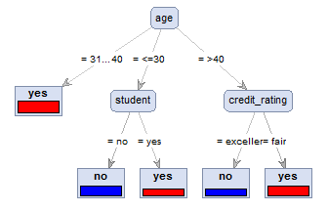
Decision Tree Induction: An Example
age | income | student | credit_rating | buys_computer
<=30 | high | no | fair | no
<=30 | high | no | excellent | no
31…40 | high | no | fair | yes
>40 | medium | no | fair | yes
>40 | low | yes | fair | yes
>40 | low | yes | excellent | no
31…40 | low | yes | excellent | yes
<=30 | medium | no | fair | no
<=30 | low | yes | fair | yes
>40 | medium | yes | fair | yes
<=30 | medium | yes | excellent | yes
31…40 | medium | no | excellent | yes
31…40 | high | yes | fair | yes
>40 | medium | no | excellent | no
Training data set: Buys_computer

Slide 22
Gain Ratio for Attribute Selection (C4.5)
Information gain measure is biased towards attributes with a large number of values
C4.5 (a successor of ID3) uses gain ratio to overcome the problem (normalization to information gain)
GainRatio(A) = Gain(A)/SplitInfo(A)
Ex.
gain_ratio(income) = 0.029/1.557 = 0.019
The attribute with the maximum gain ratio is selected as the splitting attribute

Slide 23
Gini Index (CART)
If a data set D contains examples from n classes, gini index, gini(D) is defined as
where p_{j} is the relative frequency of class j in D
If a data set D is split on A into two subsets D₁ and D₂, the gini index gini(D) is defined as
Reduction in Impurity:
The attribute provides the smallest gini_{split}(D) (or the largest reduction in impurity) is chosen to split the node (need to enumerate all the possible splitting points for each attribute)

Slide 24
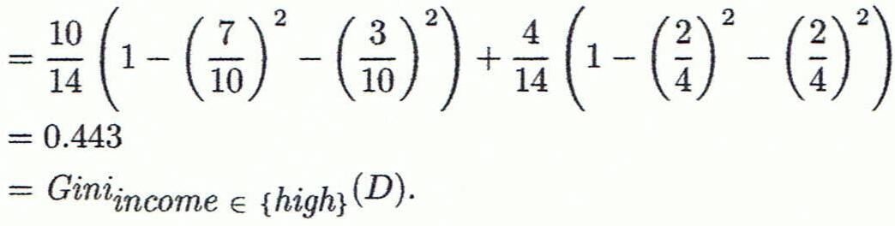
Computation of Gini Index
Ex. D has 9 tuples in buys_computer = “yes” and 5 in “no”
Suppose the attribute income partitions D into 10 in D₁: {low, medium} and 4 in D₂
Gini_{{low,high}} is 0.458; Gini_{{medium,high}} is 0.450. Thus, split on the {low,medium} (and {high}) since it has the lowest Gini index
All attributes are assumed continuous-valued
May need other tools, e.g., clustering, to get the possible split values
Can be modified for categorical attributes

Slide 25
Comparing Attribute Selection Measures
The three measures, in general, return good results but
Information gain:
biased towards multivalued attributes
Gain ratio:
tends to prefer unbalanced splits in which one partition is much smaller than the others
Gini index:
biased to multivalued attributes
has difficulty when # of classes is large
tends to favor tests that result in equal-sized partitions and purity in both partitions

Slide 26
Other Attribute Selection Measures
CHAID: a popular decision tree algorithm, measure based on χ² test for independence
C-SEP: performs better than info. gain and gini index in certain cases
G-statistic: has a close approximation to χ² distribution
MDL (Minimal Description Length) principle (i.e., the simplest solution is preferred):
The best tree as the one that requires the fewest # of bits to both (1) encode the tree, and (2) encode the exceptions to the tree
Multivariate splits (partition based on multiple variable combinations)
CART: finds multivariate splits based on a linear comb. of attrs.
Which attribute selection measure is the best?
Most give good results, none is significantly superior than others

Slide 27
Overfitting and Tree Pruning
Overfitting: An induced tree may overfit the training data
Too many branches, some may reflect anomalies due to noise or outliers
Poor accuracy for unseen samples
Two approaches to avoid overfitting
Prepruning: Halt tree construction early ̵ do not split a node if this would result in the goodness measure falling below a threshold
Difficult to choose an appropriate threshold
Postpruning: Remove branches from a “fully grown” tree -get a sequence of progressively pruned trees
Use a set of data different from the training data to decide which is the “best pruned tree”

Slide 28
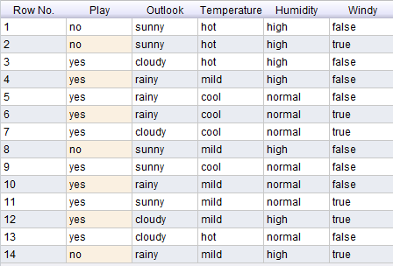
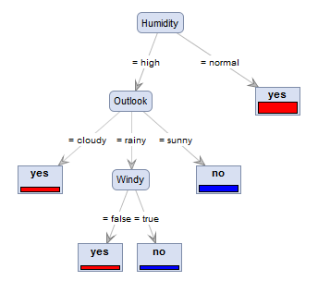
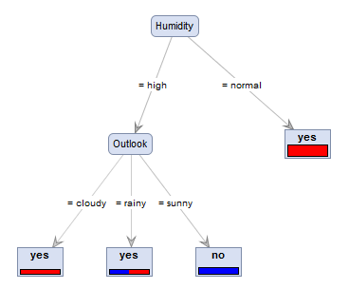
Pruning

Slide 29
Why is decision tree induction popular?
Relatively faster learning speed (than other classification methods)
Convertible to simple and easy to understand classification rules
Can use SQL queries for accessing databases
Comparable classification accuracy with other methods

